Slide 1
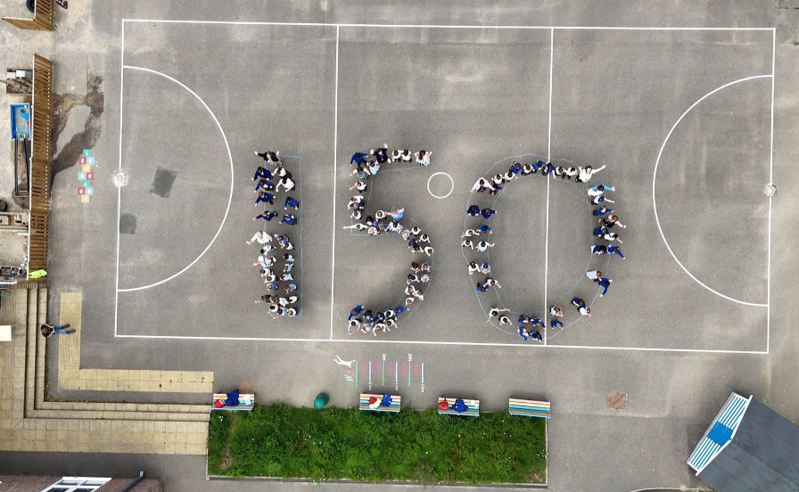

CHANGE TO THE SCHOOL UNIFORM
Thakeham Primary School
EXCELLENCE. ALWAYS.
Thakehamps.co.uk

Slide 2
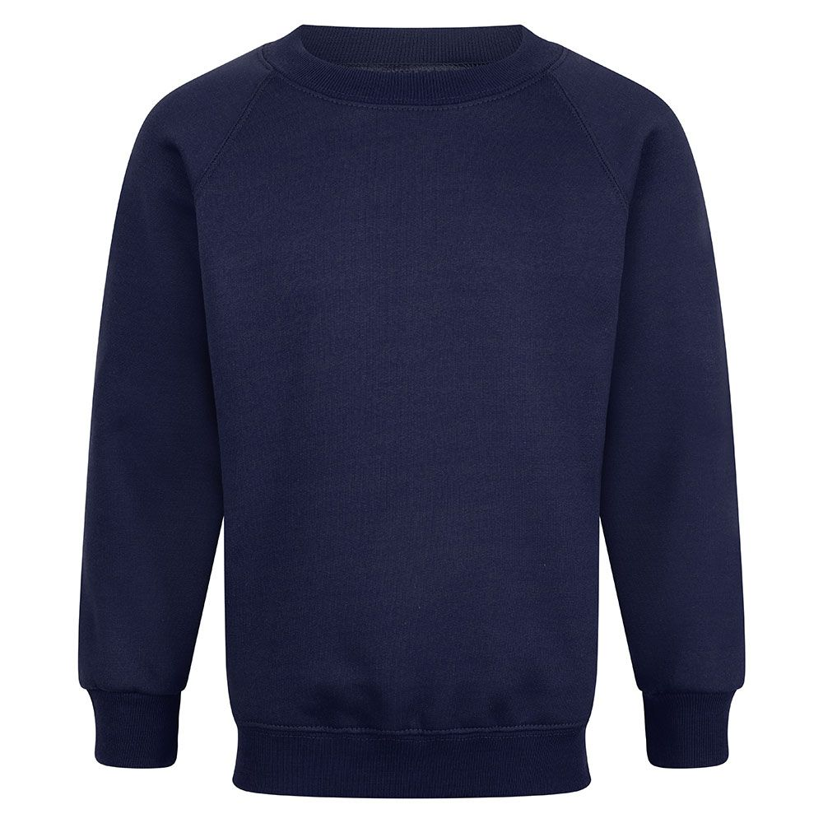

MAIN UNIFORM ITEM
Main items are those which form the main uniform.
A family can choose between a jumper or a cardigan (or have both). But, this top item must have the school logo on it. This is the only item of uniform that will need to have a logo.
Government guidelines state schools can request up to three items have a logo.
Jumper details:
Navy colour
Round collar
Jersey material
Unisex fit
School logo embroidered onto it.
Will be available from our selected supplier.
Those in receipt of pupil premium will receive funding support towards the cost of uniform.
When available, we will also carry out second hand uniform sales.

Slide 3
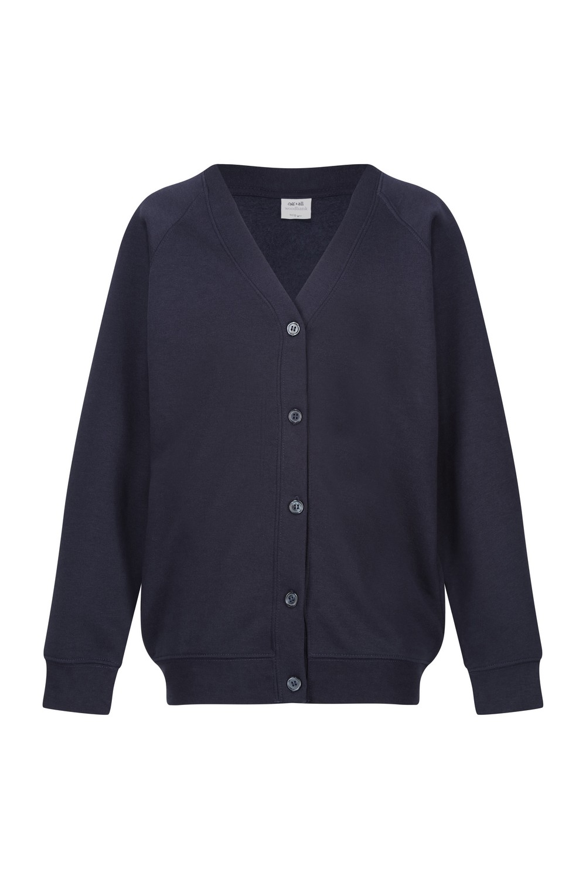
MAIN UNIFORM ITEM
Main items are those which form the main uniform.
A family can choose between a jumper or a cardigan (or have both). But, this top item must have the school logo on it. This is the only item of uniform that will need to have a logo.
Government guidelines state schools can request up to three items have a logo.
Cardigan details:
Navy colour
Jersey material
Unisex fit
School logo embroidered onto it.
Will be available from our selected supplier.
Those in receipt of pupil premium will receive funding support towards the cost of uniform.
When available, we will also carry out second hand uniform sales.

Slide 4
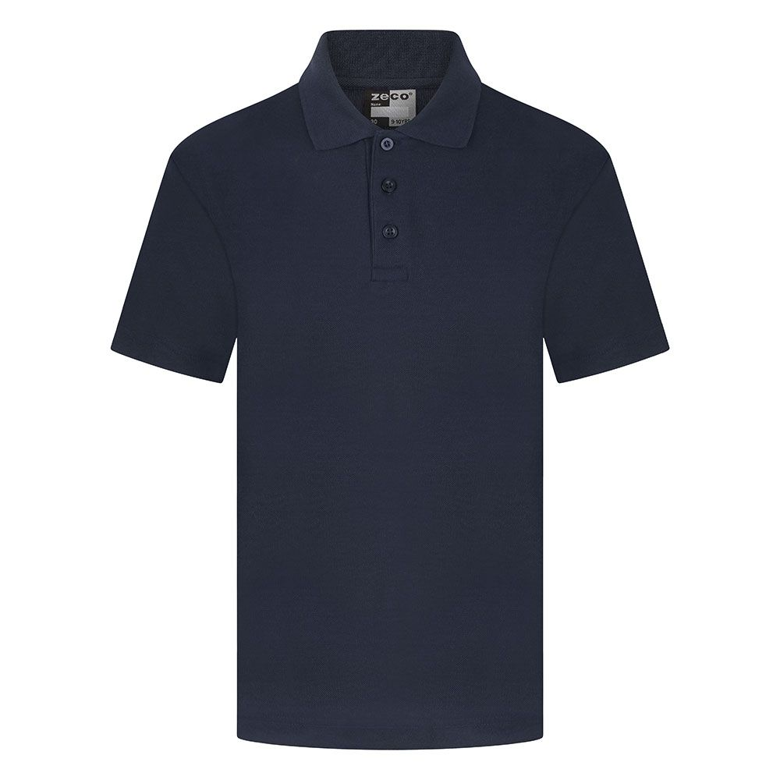
MAIN UNIFORM ITEM
Main items are those which form the main uniform.
Under the jumper or cardigan, pupils will need to wear a navy polo t-shirt. This can have the logo or be plain.
Polo t-shirt details:
Navy colour
Polo t-shirt with a collar
School logo embroidered onto it or plain.
Logo versions will be available from our selected supplier.
Plain versions can be bought from any retailer, e.g: supermarket.
Those in receipt of pupil premium will receive funding support towards the cost of uniform.
When available, we will also carry out second hand uniform sales.

Slide 5
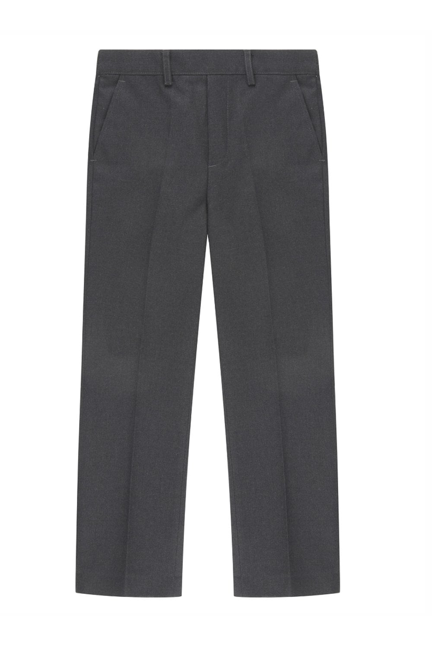
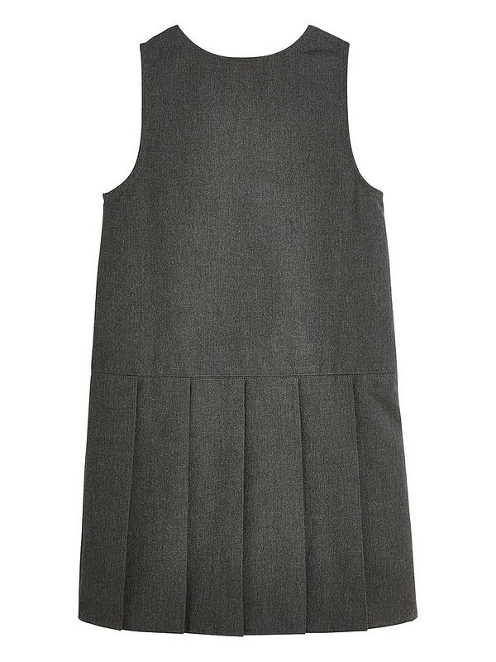
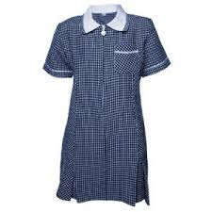
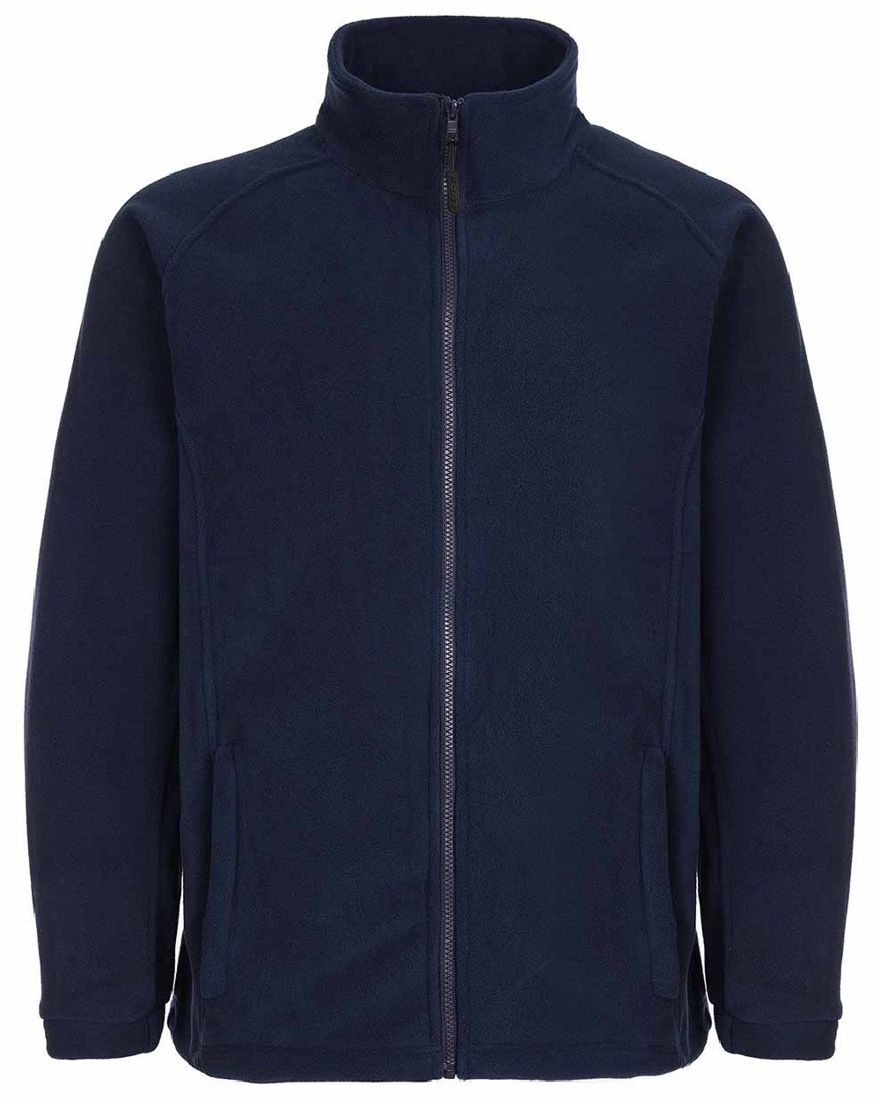
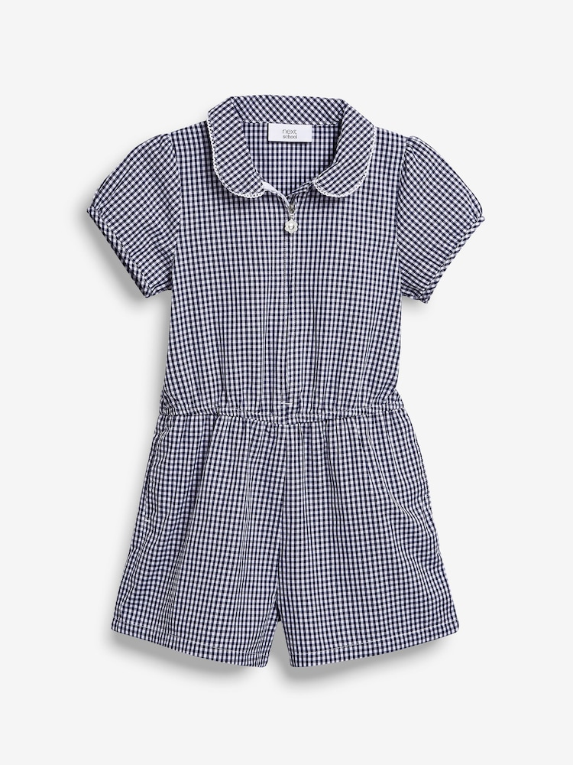
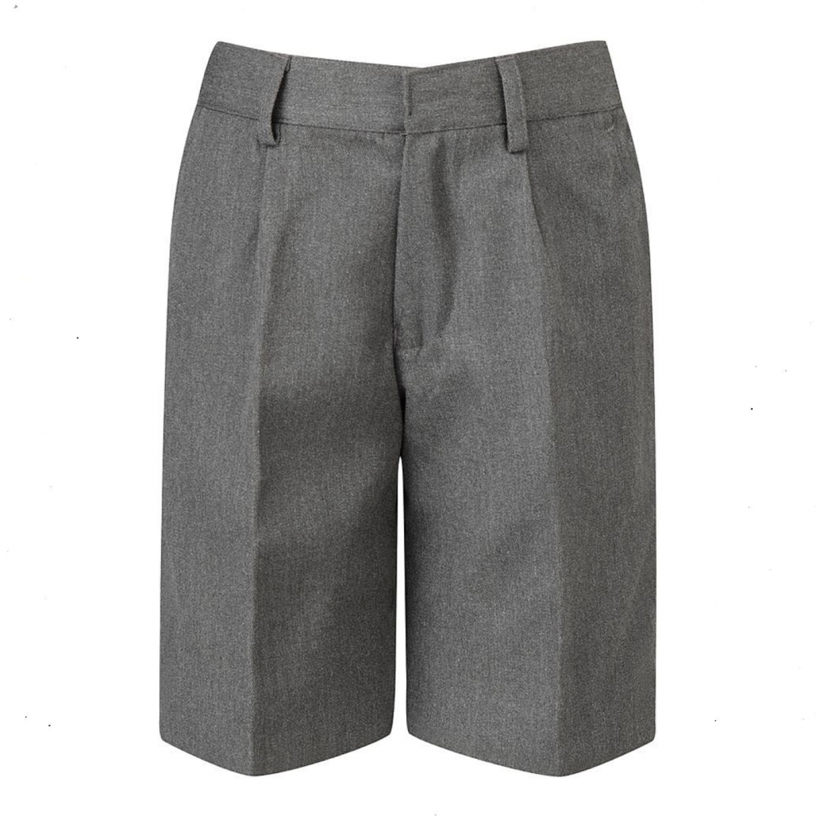
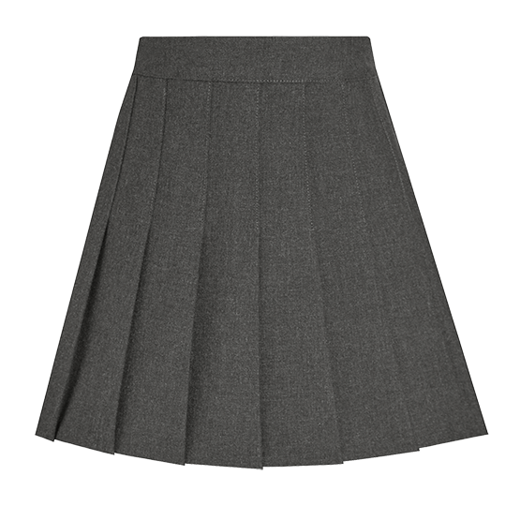
MAIN UNIFORM ITEM
Main items are those which form the main uniform.
Pupils can choose between: charcoal trousers, charcoal shorts, charcoal skirt, charcoal pinafore or a navy-blue summer dress/playsuit. These do not need to have a logo and can be bought from any supplier or shop.
Pupils can also choose to wear a navy fleece on top of their uniform. It can be plain and purchased from any retailer or a logo version purchased from our supplier.
In addition:
Black polishable shoes, small black/navy hair accessories, black/navy socks or tights.
No jewellery outside of that required for religious or cultural reasons. Ear piercings must be taped up. Items such as a watch are allowed.
Pupils in Franklin Class can bring in a pencil case and own stationery.

Slide 6
PE AND SPORTS UNIFORM
The sports uniform has been designed to look very similar
to the main uniform. This is to ensure pupils always look smart
and to make sure that all pupils are wearing similar items. It also
has been designed to be similar to an ‘active style’ uniform to
enable pupils to feel comfortable wearing it all day.
Families can choose to use the same items from the main
uniform in order to save costs or buy completely separate sets.
Items that must be worn on PE days:
The school jumper or cardigan (with a logo)
Navy blue polo t-shirt (with or without logo)
Sports trainers (can be any colour)
Plain black shorts, or…
Plain black jogging bottoms, or…
Plain black sports skirt, or…
Plain black sports leggings.
Items must not be tight to the point of revealing and skirts/shorts
must be of an acceptable length.

Slide 7


